Slide 1

Pokémon Connect 4
Notes:
Pokemon Connect 4
maecheu-teachers-tools
This template is for educational, non-commercial purposes only.
maecheu-teachers-tools.com

Slide 2
How to play.
The class will be split into teams.
Two teams will play against each other.
Place your tile by repeating the target word/sentence.
Notes:
maecheu-teachers-tools
This template is for educational, non-commercial purposes only.
maecheu-teachers-tools.com

Slide 3
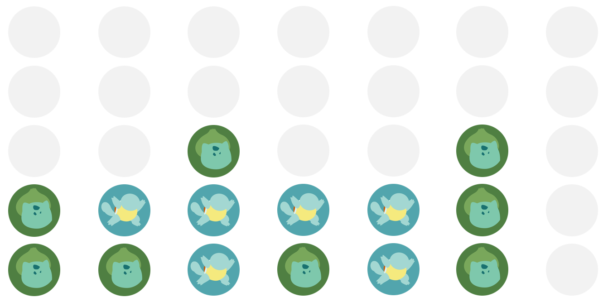
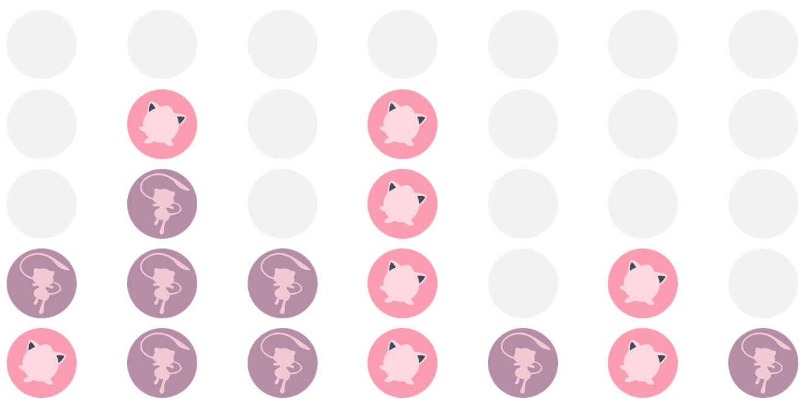
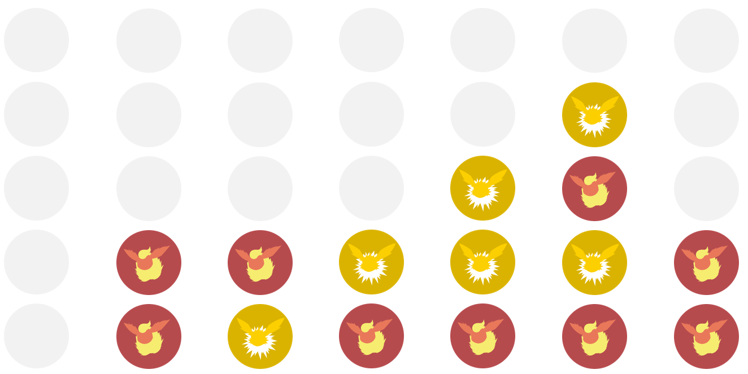
Get 4 in a row to win!
Notes:
maecheu-teachers-tools
This template is for educational, non-commercial purposes only.
maecheu-teachers-tools.com

Slide 4





MAECHEU
Text goes here
Text goes here
Text goes here
Text goes here
Text goes here
Text goes here
Text goes here
Notes:
Teacher’s Notes:
Click on the colored buttons to drop the tile into place.
‘x’ can remove the played tile.
Change games by clicking the side buttons.
maecheu-teachers-tools
This template is for educational, non-commercial purposes only.
maecheu-teachers-tools.com

Slide 5


MAECHEU
Text goes here
Text goes here
Text goes here
Text goes here
Text goes here
Text goes here
Text goes here
Notes:
Teacher’s Notes:
Click on the colored buttons to drop the tile into place.
‘x’ can remove the played tile.
Change games by clicking the side buttons.
maecheu-teachers-tools
This template is for educational, non-commercial purposes only.
maecheu-teachers-tools.com

Slide 6


MAECHEU
Text goes here
Text goes here
Text goes here
Text goes here
Text goes here
Text goes here
Text goes here
Notes:
Teacher’s Notes:
Click on the colored buttons to drop the tile into place.
‘x’ can remove the played tile.
Change games by clicking the side buttons.
maecheu-teachers-tools
This template is for educational, non-commercial purposes only.
maecheu-teachers-tools.com

