Slide 1
GRID GAME
GRID GAME
Notes:
Genshin Impact Grid Game
maecheu-teachers-tools
This template is for educational, non-commercial purposes only.
maecheu-teachers-tools.com

Slide 2
Pick 2 words: Choose one word from the side of the grid and one from the top.
Make a sentence: Use both words to create a sentence.
Notes:
How To Play:
Pick Two Words: Choose one word from the side of the grid and one from the top.
Make a Sentence: Use both words to create a sentence.
Reveal the Result: Each word combination will either give you a reward or a punishment.
Teacher’s notes:
Click the corresponding star to be taken to rewards page.
maecheu-teachers-tools
This template is for educational, non-commercial purposes only.
maecheu-teachers-tools.com

Slide 3
Reveal the result: Each combination will either give you a reward or punishment.
Notes:
How To Play:
Pick Two Words: Choose one word from the side of the grid and one from the top.
Make a Sentence: Use both words to create a sentence.
Reveal the Result: Each word combination will either give you a reward or a punishment.
Teacher’s notes:
Click the corresponding star to be taken to rewards page.
maecheu-teachers-tools
This template is for educational, non-commercial purposes only.
maecheu-teachers-tools.com

Slide 4
1 2 3 4 5 6
3 4 5 6 1 2
5 6 1 2 3 4
2 3 4 5 6 1
4 5 6 1 2 3
Word/
picture
Word/
picture
Word/
picture
Word/
picture
Word/
picture
Word/
picture
Word
Word
Word
Word
Word
Notes:
How To Play:
Pick Two Words: Choose one word from the side of the grid and one from the top.
Make a Sentence: Use both words to create a sentence.
Reveal the Result: Each word combination will either give you a reward or a punishment.
Teacher’s notes:
Click the corresponding star to be taken to rewards page.
maecheu-teachers-tools
This template is for educational, non-commercial purposes only.
maecheu-teachers-tools.com

Slide 5
2
Points
Notes:
Teacher’s notes:
Automatic reveal
CLICK:
Left icon= Return to grid.
maecheu-teachers-tools
This template is for educational, non-commercial purposes only.

Slide 6
6
Points
Notes:
Teacher’s notes:
Automatic reveal
CLICK:
Left icon= Return to grid.
maecheu-teachers-tools
This template is for educational, non-commercial purposes only.

Slide 7
2
Points
Notes:
Teacher’s notes:
Automatic reveal
CLICK:
Left icon= Return to grid.
maecheu-teachers-tools
This template is for educational, non-commercial purposes only.

Slide 8
2
Points
Notes:
Teacher’s notes:
Automatic reveal
CLICK:
Left icon= Return to grid.
maecheu-teachers-tools
This template is for educational, non-commercial purposes only.

Slide 9
3
Points
Notes:
Teacher’s notes:
Automatic reveal
CLICK:
Left icon= Return to grid.
maecheu-teachers-tools
This template is for educational, non-commercial purposes only.

Slide 10
4
Points
Notes:
Teacher’s notes:
Automatic reveal
CLICK:
Left icon= Return to grid.
maecheu-teachers-tools
This template is for educational, non-commercial purposes only.

Slide 11
3
Points
Notes:
Teacher’s notes:
Automatic reveal
CLICK:
Left icon= Return to grid.
maecheu-teachers-tools
This template is for educational, non-commercial purposes only.

Slide 12
Lose
Lose all points.

Slide 13
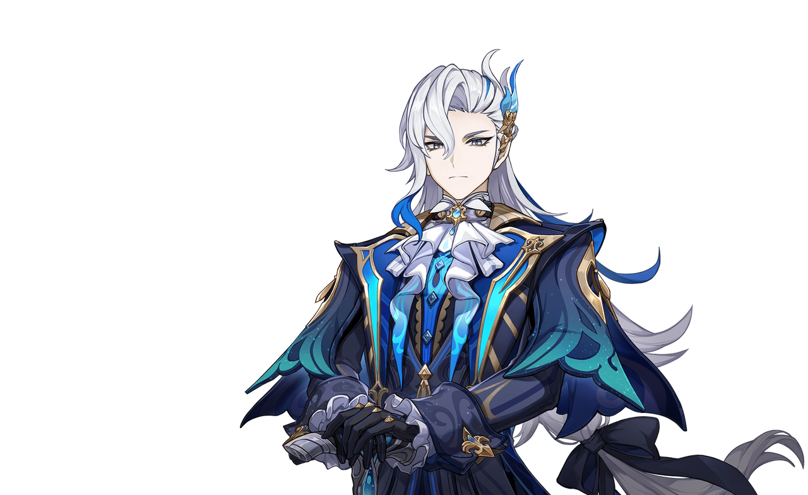
Fight
Rock, paper scissors,
Winner steals 3 points.
Notes:
Teacher’s notes:
Automatic reveal
Team to choose another team to go against, whoever wins steals 3 points from the other team.
CLICK:
Left icon= Return to grid
maecheu-teachers-tools
This template is for educational, non-commercial purposes only.
maecheu-teachers-tools.com

Slide 14
5
Points
Notes:
Teacher’s notes:
Automatic reveal
CLICK:
Left icon= Return to grid.
maecheu-teachers-tools
This template is for educational, non-commercial purposes only.

Slide 15
2
Points
Notes:
Teacher’s notes:
Automatic reveal
CLICK:
Left icon= Return to grid.
maecheu-teachers-tools
This template is for educational, non-commercial purposes only.

Slide 16
4
Points
Notes:
Teacher’s notes:
Automatic reveal
CLICK:
Left icon= Return to grid.
maecheu-teachers-tools
This template is for educational, non-commercial purposes only.

Slide 17
6
Points
Notes:
Teacher’s notes:
Automatic reveal
CLICK:
Left icon= Return to grid.
maecheu-teachers-tools
This template is for educational, non-commercial purposes only.

Slide 18
2
Points
Notes:
Teacher’s notes:
Automatic reveal
CLICK:
Left icon= Return to grid.
maecheu-teachers-tools
This template is for educational, non-commercial purposes only.

Slide 19
5
Points
Notes:
Teacher’s notes:
Automatic reveal
CLICK:
Left icon= Return to grid.
maecheu-teachers-tools
This template is for educational, non-commercial purposes only.

Slide 20
5
Points
Notes:
Teacher’s notes:
Automatic reveal
CLICK:
Left icon= Return to grid.
maecheu-teachers-tools
This template is for educational, non-commercial purposes only.

Slide 21
Fight
Rock, paper scissors,
Winner steals 3 points.
Notes:
Teacher’s notes:
Automatic reveal
Team to choose another team to go against, whoever wins steals 3 points from the other team.
CLICK:
Left icon= Return to grid.
maecheu-teachers-tools
This template is for educational, non-commercial purposes only.
maecheu-teachers-tools.com

Slide 22
2
Points
Notes:
Teacher’s notes:
Automatic reveal
CLICK:
Left icon= Return to grid.
maecheu-teachers-tools
This template is for educational, non-commercial purposes only.

Slide 23
3
Points
Notes:
Teacher’s notes:
Automatic reveal
CLICK:
Left icon= Return to grid.
maecheu-teachers-tools
This template is for educational, non-commercial purposes only.

Slide 24
2
Points
Notes:
Teacher’s notes:
Automatic reveal
CLICK:
Left icon= Return to grid.
maecheu-teachers-tools
This template is for educational, non-commercial purposes only.

Slide 25
3
Points
Notes:
Teacher’s notes:
Automatic reveal
CLICK:
Left icon= Return to grid.
maecheu-teachers-tools
This template is for educational, non-commercial purposes only.

Slide 26
Fight
Rock, paper scissors.
If the choosing team wins,
Switch points.
Notes:
Teacher’s notes:
Automatic reveal
Team to choose another team to go against, if that team wins switch points, if they lose nothing happens.
CLICK:
Left icon= Return to grid.
maecheu-teachers-tools
This template is for educational, non-commercial purposes only.
maecheu-teachers-tools.com

Slide 27
3
Points
Notes:
Teacher’s notes:
Automatic reveal
CLICK:
Left icon= Return to grid.
maecheu-teachers-tools
This template is for educational, non-commercial purposes only.

Slide 28
Fight
Rock, paper scissors.
If the choosing team wins,
Switch points.
Notes:
Teacher’s notes:
Automatic reveal
Team to choose another team to go against, if that team wins switch points, if they lose nothing happens.
CLICK:
Left icon= Return to grid.
maecheu-teachers-tools
This template is for educational, non-commercial purposes only.
maecheu-teachers-tools.com

Slide 29
6
Points
Notes:
Teacher’s notes:
Automatic reveal
CLICK:
Left icon= Return to grid.
maecheu-teachers-tools
This template is for educational, non-commercial purposes only.

Slide 30
3
Points
Notes:
Teacher’s notes:
Automatic reveal
CLICK:
Left icon= Return to grid.
maecheu-teachers-tools
This template is for educational, non-commercial purposes only.

Slide 31
2
Points
Notes:
Teacher’s notes:
Automatic reveal
CLICK:
Left icon= Return to grid.
maecheu-teachers-tools
This template is for educational, non-commercial purposes only.

Slide 32
4
Points
Notes:
Teacher’s notes:
Automatic reveal
CLICK:
Left icon= Return to grid.
maecheu-teachers-tools
This template is for educational, non-commercial purposes only.

Slide 33
2
Points
Notes:
Teacher’s notes:
Automatic reveal
CLICK:
Left icon= Return to grid.
maecheu-teachers-tools
This template is for educational, non-commercial purposes only.

Slide 34
Lose
Lose all points.
Notes:
Teacher’s notes:
Automatic reveal
CLICK:
Left icon= Return to grid.
maecheu-teachers-tools
This template is for educational, non-commercial purposes only.

