Slide 1
N C O T
K O K U
Notes:
Tom And Jerry Knockout
maecheu-teachers-tools
This template is for educational, non-commercial purposes only.
maecheu-teachers-tools.com

Slide 2
How to play
All students will stand up.
Choose: One student will choose a box and read the word/sentence.
Behind the box there is a number.
Notes:
How to play:
Each student is numbered, a student will choose a box and repeat the word/sentence. The student whose number is revealed is out and will choose another box to read.
This continues until there is one winner.
maecheu-teachers-tools
This template is for educational, non-commercial purposes only.
maecheu-teachers-tools.com

Slide 3
How to play
Elimination: If it is your number, you are out.
Before sitting down you will then choose another box and read the sentence.
Notes:
How to play:
Each student is numbered, a student will choose a box and repeat the word/sentence. The student whose number is revealed is out and will choose another box to read.
This continues until there is one winner.
maecheu-teachers-tools
This template is for educational, non-commercial purposes only.
maecheu-teachers-tools.com

Slide 4
How to play
The last student standing is the winner!
Notes:
How to play:
Each student is numbered, a student will choose a box and repeat the word/sentence. The student whose number is revealed is out and will choose another box to read.
This continues until there is one winner.
maecheu-teachers-tools
This template is for educational, non-commercial purposes only.
maecheu-teachers-tools.com

Slide 5
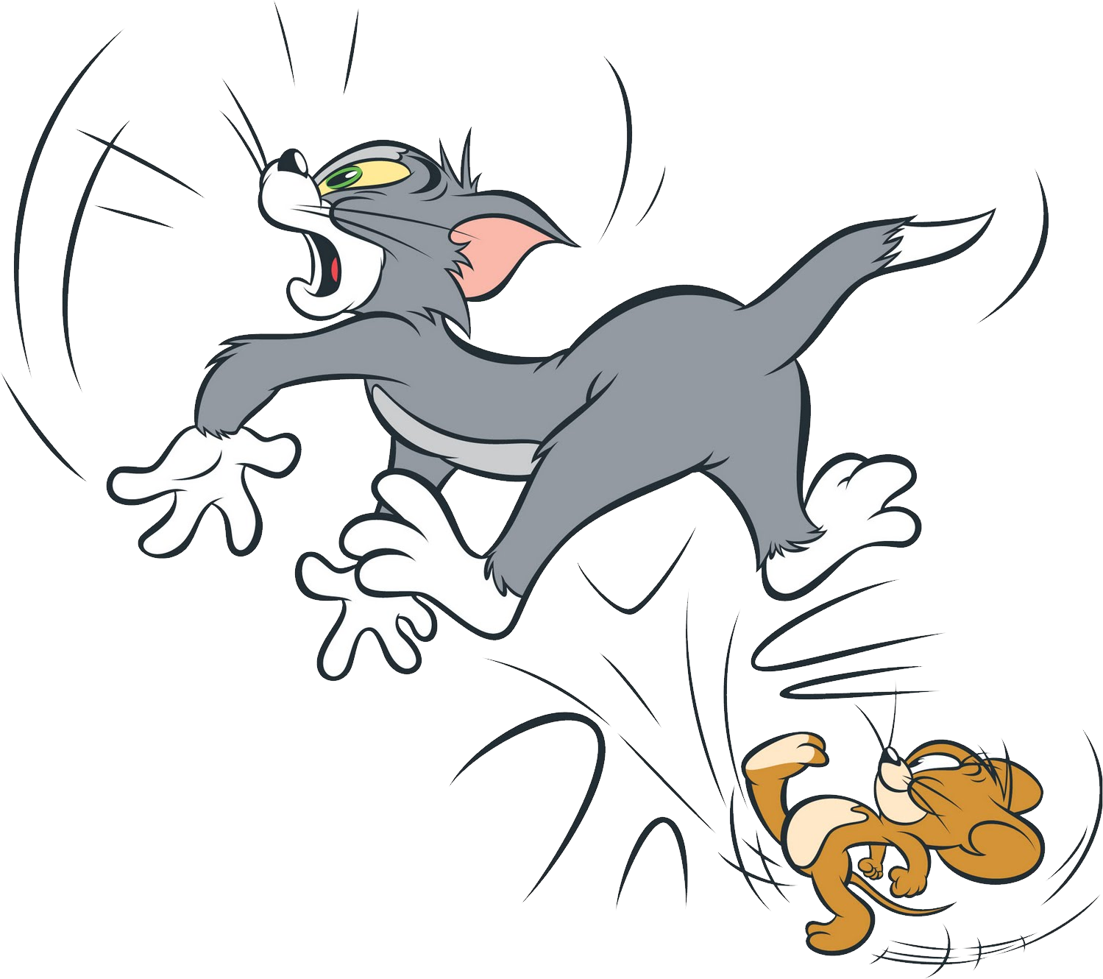
ROUND 1
Notes:
maecheu-teachers-tools
This template is for educational, non-commercial purposes only.
maecheu-teachers-tools.com

Slide 6
Text goes here
1
Text goes here
26
Text goes here
12
Text goes here
3
Text goes here
6
Text goes here
25
Text goes here
5
Text goes here
20
Text goes here
24
Text goes here
14
Text goes here
16
Text goes here
17
Text goes here
9
Text goes here
28
Notes:
Teacher’s Notes:
Click the tile to reveal the number.
If there are less students than numbers the student must choose again.
maecheu-teachers-tools
This template is for educational, non-commercial purposes only.
maecheu-teachers-tools.com

Slide 7
Text goes here
7
Text goes here
8
Text goes here
19
Text goes here
15
Text goes here
10
Text goes here
18
Text goes here
21
Text goes here
2
Text goes here
27
Text goes here
23
Text goes here
4
Text goes here
13
Text goes here
22
Text goes here
11
Notes:
Teacher’s Notes:
Click the tile to reveal the number.
If there are less students than numbers the student must choose again.
maecheu-teachers-tools
This template is for educational, non-commercial purposes only.
maecheu-teachers-tools.com

Slide 8
ROUND 2
Notes:
maecheu-teachers-tools
This template is for educational, non-commercial purposes only.
maecheu-teachers-tools.com

Slide 9
Text goes here
21
Text goes here
4
Text goes here
20
Text goes here
10
Text goes here
26
Text goes here
Text goes here
14
Text goes here
18
Text goes here
15
Text goes here
9
5
Text goes here
22
Text goes here
8
Text goes here
11
Text goes here
28
Notes:
Teacher’s Notes:
Click the tile to reveal the number.
If there are less students than numbers the student must choose again.
maecheu-teachers-tools
This template is for educational, non-commercial purposes only.
maecheu-teachers-tools.com

Slide 10
Text goes here
6
Text goes here
27
Text goes here
16
Text goes here
2
Text goes here
25
Text goes here
Text goes here
1
Text goes here
19
Text goes here
13
Text goes here
17
24
Text goes here
7
Text goes here
12
Text goes here
3
Text goes here
23
Notes:
Teacher’s Notes:
Click the tile to reveal the number.
If there are less students than numbers the student must choose again.
maecheu-teachers-tools
This template is for educational, non-commercial purposes only.
maecheu-teachers-tools.com

Slide 11
ROUND 3
Notes:
maecheu-teachers-tools
This template is for educational, non-commercial purposes only.
maecheu-teachers-tools.com

Slide 12
Text goes here
12
Text goes here
3
Text goes here
23
Text goes here
16
Text goes here
27
Text goes here
Text goes here
14
Text goes here
9
Text goes here
25
Text goes here
7
5
Text goes here
21
Text goes here
18
Text goes here
1
Text goes here
20
Notes:
Teacher’s Notes:
Click the tile to reveal the number.
If there are less students than numbers the student must choose again.
maecheu-teachers-tools
This template is for educational, non-commercial purposes only.
maecheu-teachers-tools.com

Slide 13
Text goes here
26
Text goes here
15
Text goes here
22
Text goes here
4
Text goes here
17
Text goes here
Text goes here
24
Text goes here
8
Text goes here
13
Text goes here
6
28
Text goes here
11
Text goes here
2
Text goes here
19
Text goes here
10
Notes:
Teacher’s Notes:
Click the tile to reveal the number.
If there are less students than numbers the student must choose again.
maecheu-teachers-tools
This template is for educational, non-commercial purposes only.
maecheu-teachers-tools.com

Slide 14
ROUND 4
Notes:
maecheu-teachers-tools
This template is for educational, non-commercial purposes only.
maecheu-teachers-tools.com

Slide 15
Text goes here
2
Text goes here
11
Text goes here
10
Text goes here
26
Text goes here
15
Text goes here
Text goes here
19
Text goes here
4
Text goes here
22
Text goes here
17
6
Text goes here
24
Text goes here
13
Text goes here
8
Text goes here
28
Notes:
Teacher’s Notes:
Click the tile to reveal the number.
If there are less students than numbers the student must choose again.
maecheu-teachers-tools
This template is for educational, non-commercial purposes only.
maecheu-teachers-tools.com

Slide 16
Text goes here
7
Text goes here
27
Text goes here
12
Text goes here
5
Text goes here
1
Text goes here
Text goes here
25
Text goes here
9
Text goes here
23
Text goes here
18
16
Text goes here
21
Text goes here
14
Text goes here
3
Text goes here
20
Notes:
Teacher’s Notes:
Click the tile to reveal the number.
If there are less students than numbers the student must choose again.
maecheu-teachers-tools
This template is for educational, non-commercial purposes only.
maecheu-teachers-tools.com

Slide 17
Finish
Notes:
maecheu-teachers-tools
This template is for educational, non-commercial purposes only.
maecheu-teachers-tools.com

